Slide 1

The role of stress-induced mutation in the emergence of complex adaptations
Yoav Ram & Lilach Hadany
SIDEER Symposium 2013
Sede Boqer, Israel

Slide 2




Acknowledgments
Dr. Lilach Hadany
https://sites.google.com/site/hadanylab
The George S. Wise Faculty of Life Sciences
The Department of Molecular Biology and Ecology in Plants
Amalia Biron-Zigle
Foundation

Slide 3

Mutation
“Mutations … supply the raw materials for evolution”
Dobzhansky T, Genetics and Origin of Species 1937
“Mutation is the ultimate source of variation on which natural selection acts”
Lynch M, PNAS 2007

Slide 4
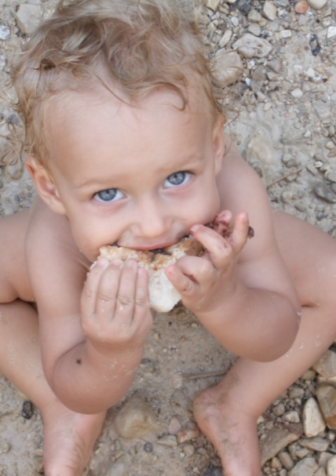
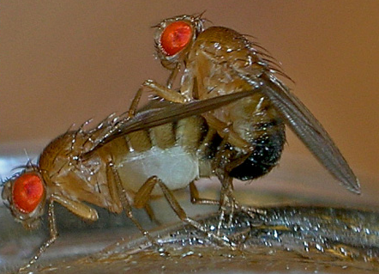
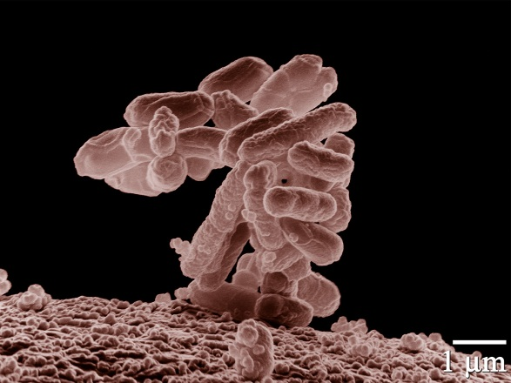
Variation in mutation rates
Between species
“Noticeable” mutations per genome per generation
Mammals (H. sapiens): XXX (XXX)
Flies (D. melanogaster): XXX (XXX)
Bacteria (E. coli): 0.003 (Drake 1991)

Slide 5
Variation in mutation rates
Between populations
Mutation rate of 69 natural isolates of E. coli - Matic et al. 1997

Slide 6
Variation in mutation rates
Within individuals
Error rates DNA polymerases – Lynch 2011

Slide 7
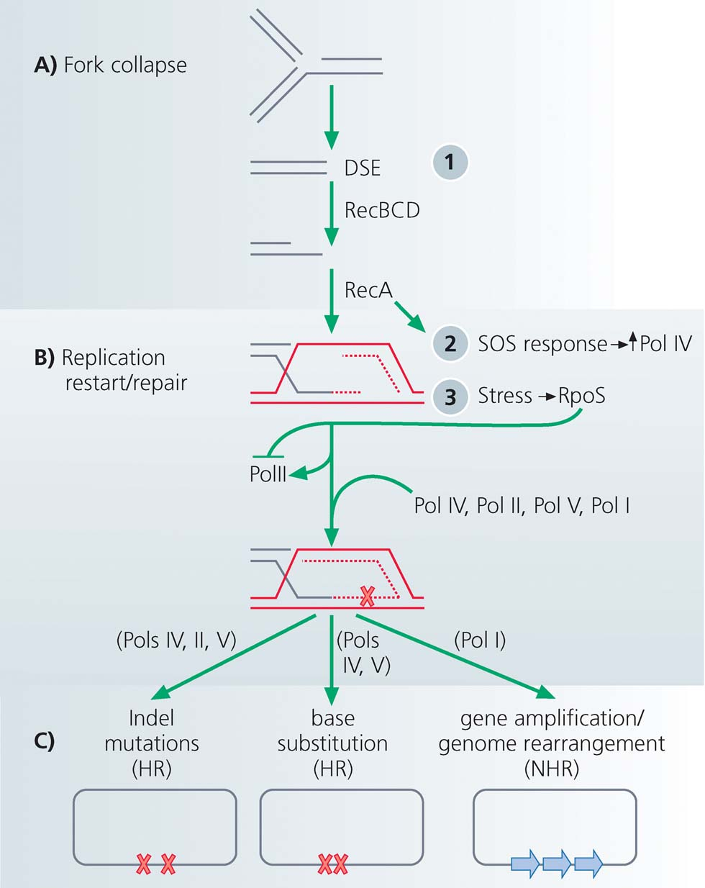
Stress-induced mutation
Rosenberg et al. 2012
Error prone DNA polymerases are induced by stress responses:
SOS response
Carbon starvation
DNA damage
In E. coli

Slide 8
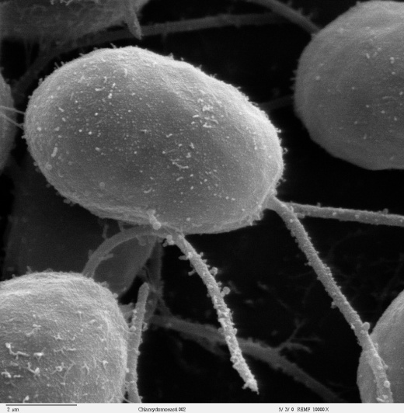
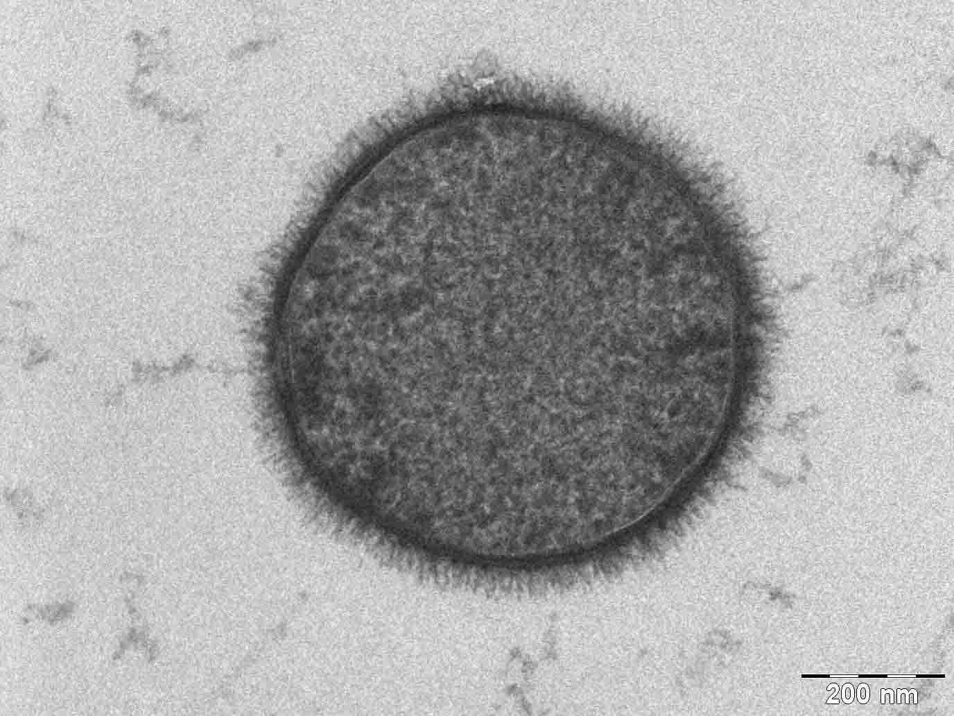
C. reinhardtii
Evidence
Bacteria
Escherichia coli Bjedov et al. 2003
Bacillus subtilis Sung and Yasbin 2002
Pseudomonas putida Kivisaar 2010
Pseudomonas aeruginosa Weigand & Sundin 2012
Listeria monocytogenes van der Veen et al. 2010
Staphylococcus aureus Cirz et al. 2007
Mycobacterium tuberculosis Boshoff et al. 2003
Eukaryote
Chlamydomonas reinhardtii Goho & Bell 2000
Saccharomyces cerevisiae Hall 1992; Heidenreich 2007
Caenorhabditis elegans & briggsae Matsuba et al. 2012
Drosophila melanogaster Sharp & Agrawal 2012
Human cancer cells Hara et al. 2005; Bristow & Hill 2008
Reviewed by Foster 2007; Galhardo et al. 2007; Rosenberg et al. 2012; Poole 2012
B. subtilis

Slide 9
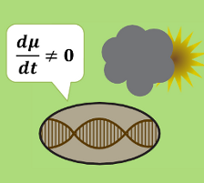
Evolution of Stress-Induced Mutation
Null Hypothesis: mutation is a by-product of stress
Alternative, non-adaptive hypotheses:
Cost of DNA replication fidelity (Dawson 1998)
Drift barrier hypothesis (Lynch 2010, 2011)
Adaptive hypothesis:
“…the evolutionary consequence of SIM is that bacteria are able to adapt rapidly to stressful environments…”
MacLean et al. 2013

Slide 10
Evolution of Stress-Induced Mutation
Deterministic model
Stochastic model
Constant environment
Infinite homogenous populations
Steady state analysis
General solution
Changing environment
Finite populations
Competitions between mutational strategies
Fixation and extinction
Simulations
Ram & Hadany, Evolution 2012

Slide 11
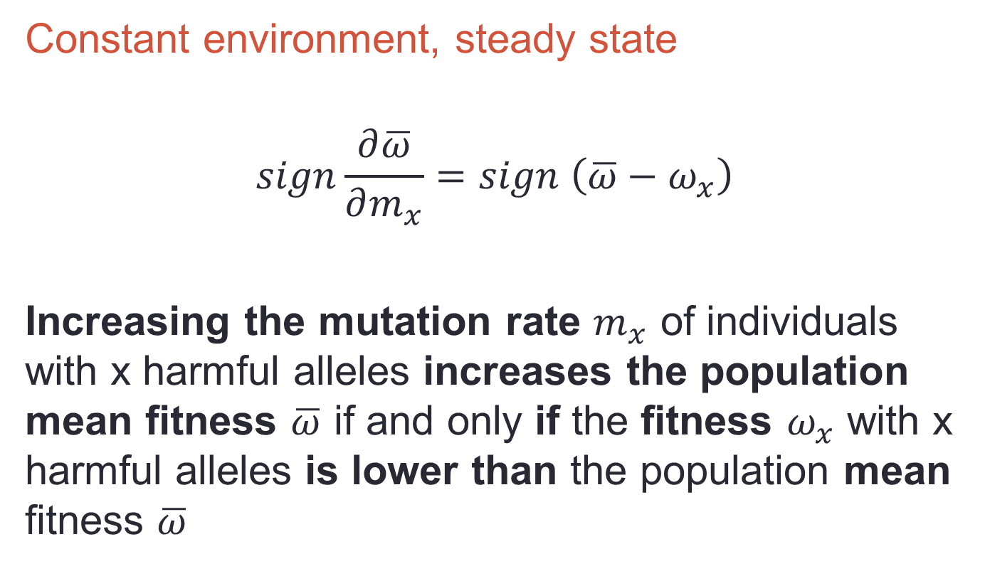
Deterministic model
Constant environment, steady state
$$sign\frac{∂\overline{ω}}{∂m_{x}}=sign \left(\overline{ω}−ω_{x}\right)$$
Increasing the mutation rate $m_{x}$ of individuals with x harmful alleles increases the population mean fitness $\overline{ω}$ if and only if the fitness $ω_{x}$ with x harmful alleles is lower than the population mean fitness $\overline{ω}$

Slide 12
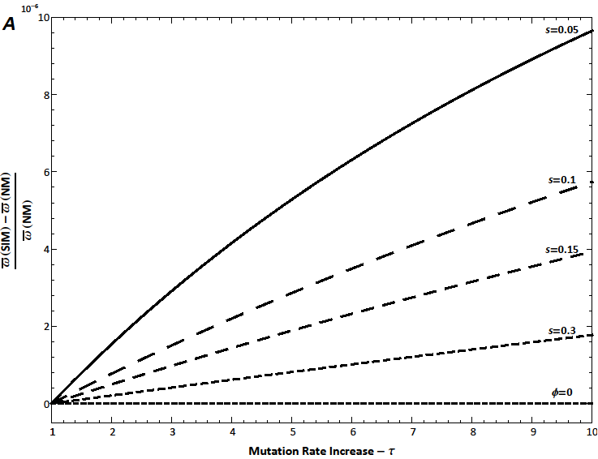
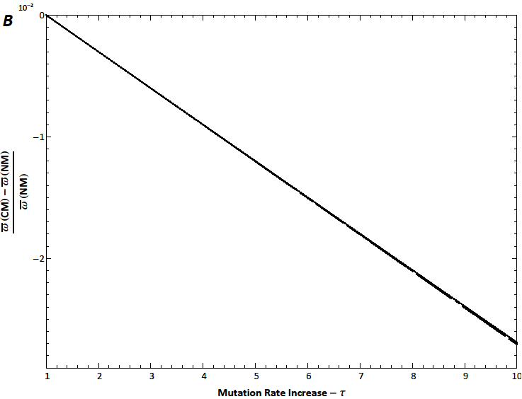
Results
SIM vs. NM
NM - Non-mutators
constant low rate of mutation
CM - Constitutive mutators
Constant high rate of mutation
SIM - Stress-induced mutators
Low mutation rate when well-adapted
High mutation rate when stressed
No Beneficial Mutations
Relative Fitness Advantage
CM vs. NM
Mutation Rate Increase

Slide 13
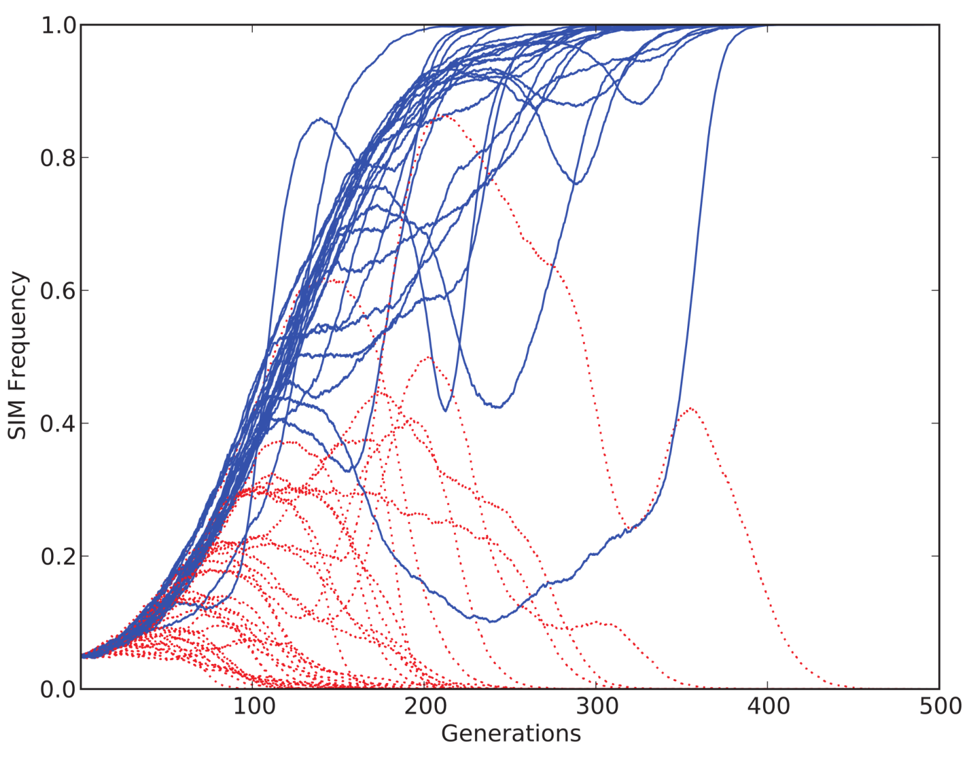
Stochastic model
Changing environment, competitions
Notes:
SIM π=1 τ=10 vs. CM τ=10; 60 replicates, SIM starts at 5% and wins in 40% (25/60, P<10⁻¹⁶)

Slide 14
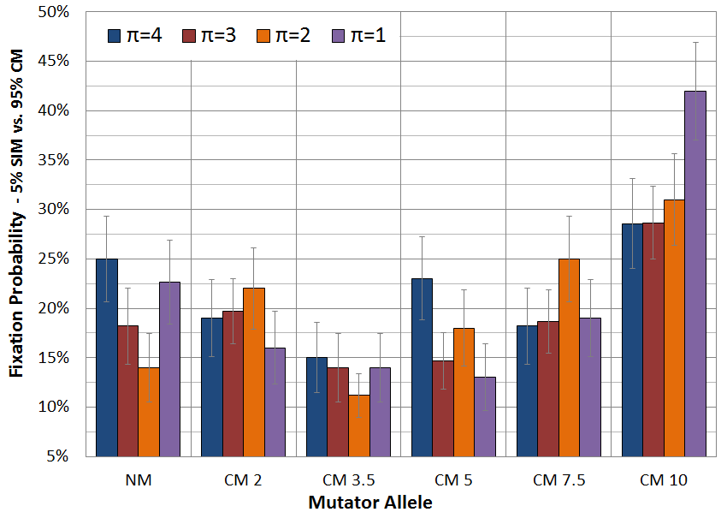
Competitions Summary
Notes:
SIM vs. CM, up to 500 generations, SIM starts at 5%, # replicates>100, µ=0.003, error bars: ±1 SE, P<0.001

Slide 15
Evolution of Stress-Induced Mutation
Summary
Stress-induced mutation favored by selection over constant rate mutation
Both in changing and constant environments
Caveats
No recombination or sex
Simple log-linear fitness landscape
Ram & Hadany, Evolution 2012

Slide 16
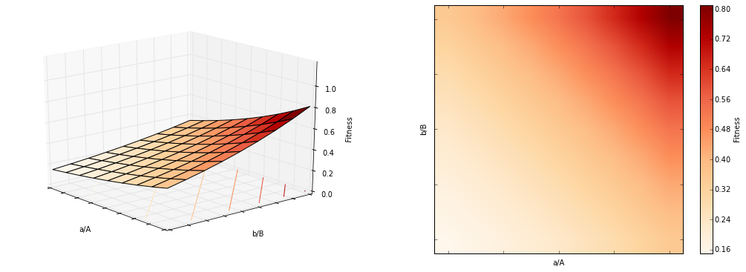
Smooth Fitness Landscape
Fitness:
ab (1-s)²
Ab 1-s
aB 1-s
AB 1

Slide 17
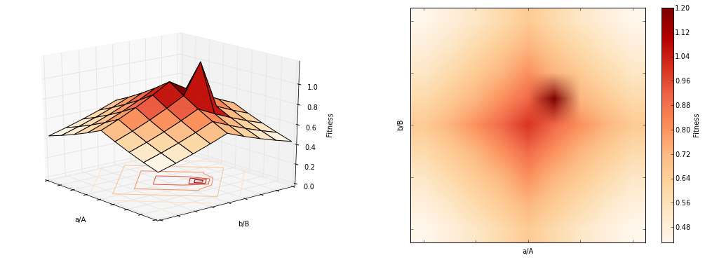
Rugged Fitness Landscape
Fitness:
ab 1
Ab 1-s
aB 1-s
AB 1+s

Slide 18
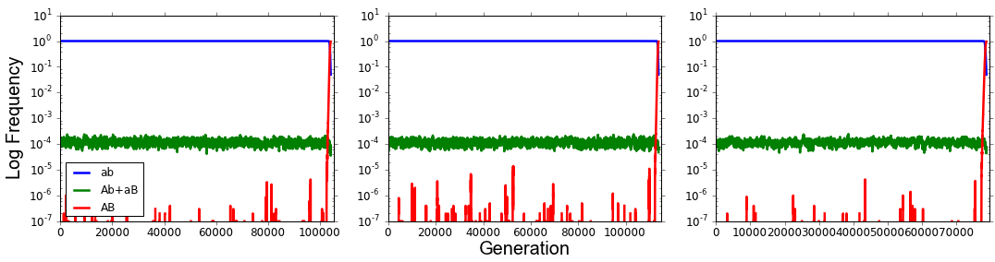
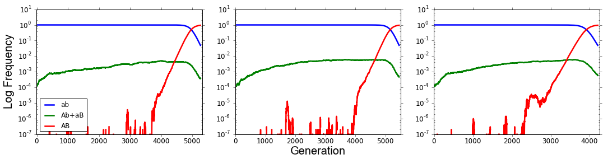
Adaptation on Fitness Landscapes
Rugged Landscape
100,000
100,000
70,000
Smooth Landscape
5,000
5,000
4,000
Notes:
N=10^7, s=0.01, H=1, U=0.003, u=U/5000

Slide 19
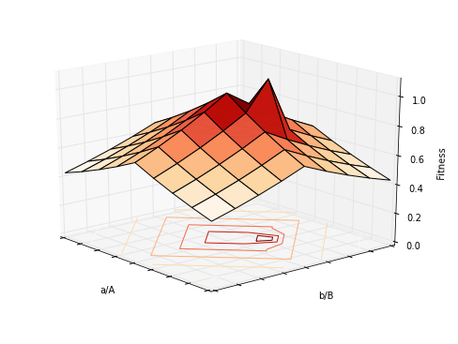
Stress-induced mutation on rugged landscapes
Mutation rates increased in individuals below the peaks
Increases transition from aB and Ab to AB
Increases advantage of AB
Low mutation rate
High mutation rate

Slide 20
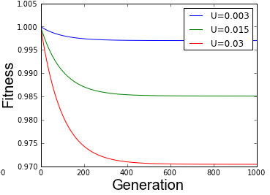

Mutational load
Increased mutation rates cause mutation loads
Expected mean fitness at generation g with mutation rate U and selection coefficient s:
$$\overline{ω}\left(g\right)=e^{−U(1−{\left(1−s\right)}^{g})}\overset{→}{g→∞}e^{−U}$$
Gordo & Dionisio 2005, Blog post

Slide 21

Appearance of a double mutant
The probability of the appearance of a double mutant
Constant mutation rate:
$$e^{−τU}\frac{{\left(τμ\right)}^{2}}{s}(2+s−τU)$$
Stress-induced mutation rate:
$$e^{−U}\frac{μ^{2}}{s}(2τe^{−U\left(τ−1\right)}+s−U)$$
Constant > Stress-induced

Slide 22
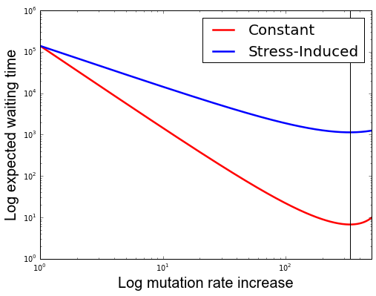
Appearance of a double mutant
The probability of the appearance of a double mutant
Constant mutation rate:
$$e^{−τU}\frac{{\left(τμ\right)}^{2}}{s}(2+s−τU)$$
Stress-induced mutation rate:
$$e^{−U}\frac{μ^{2}}{s}(2τe^{−U\left(τ−1\right)}+s−U)$$
Constant > Stress-induced

Slide 23

Fixation of a double mutant
The probability of the fixation of a double mutant
Constant mutation rate:
$$2s$$
Stress-induced mutation rate:
$$1−\frac{1−\frac{U}{s}\left(1−U\right)\left(1−s\right)}{1+s}$$
Constant < Stress-induced

Slide 24
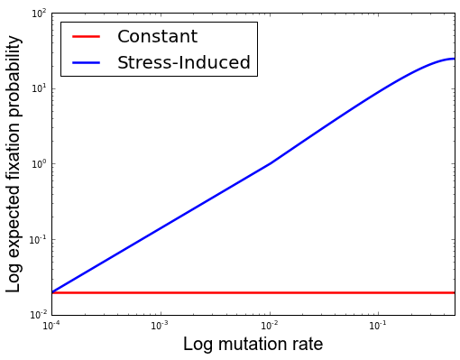
Fixation of a double mutant
The probability of the fixation of a double mutant
Constant mutation rate:
$$2s$$
Stress-induced mutation rate:
$$1−\frac{1−\frac{U}{s}\left(1−U\right)\left(1−s\right)}{1+s}$$
Constant < Stress-induced

Slide 25
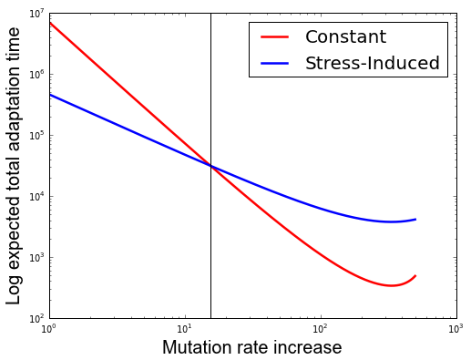
Total adaptation time
= Waiting time / fixation probability
15.5
Adaptation time shorter for stress-induced mutation when the mutation rate increase is not too high

Slide 26
Competition during waiting time
The waiting time is much longer than the fixation time
Waiting time
Fixation time

Slide 27
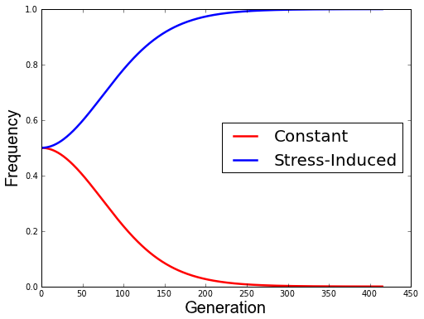
Competition during waiting time
During this time SIM outcompetes CM
Waiting time is ~138,820 generations
In a population of 100,000 individuals

Slide 28
Adaptation with stress-induced mutation
The End
email: yoavram@post.tau.ac.il website: http://www.yoavram.com

